Slide 1
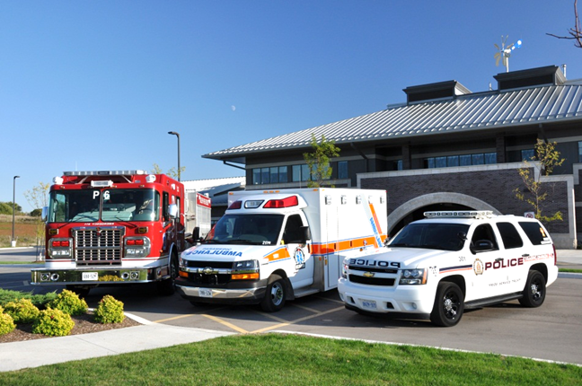
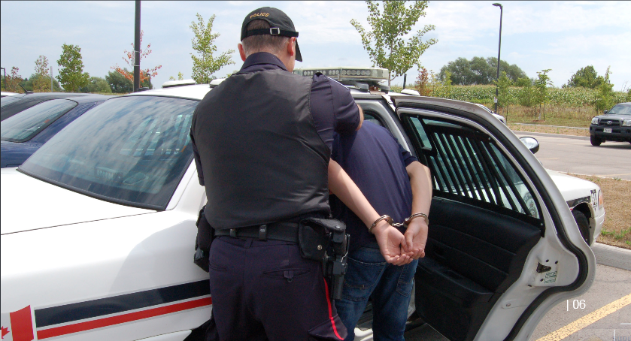
PTSD and Emergency Responders
An overview of the literature

Slide 2
Goals
Define what PTSD is (and isn’t)
Symptoms of PTSD
Triggers of PTSD and other influences
Traumatic stress continuum
Preventing PTSD
Treating PTSD
Taxonomy of research necessary to help manage PTSD in emergency responder community

Slide 3
Disclaimer
Many areas of literature are underdeveloped
The “best practices” were identified on the basis of a literature review only
As such, they would need to be validated with PTSD experts before implementation

Slide 4
What is PTSD?
Post-traumatic stress disorder can be defined as:
  a condition where symptoms evolve in the aftermath of an extreme traumatic stressor that overwhelms the individual’s coping capacities
  a progressive symptomatic response to traumatic stress that fails to recede after at least 30 days

Slide 5
What triggers PTSD?
PTSD can be triggered by any one of the following:
  directly experiencing a traumatic event;
  witnessing a traumatic event in person;
  learning that a traumatic event (violent or accidental) happened to a loved one;
  experiencing repeated or extreme exposure to details of a traumatic event
  PTSD can occur because of both direct (e.g., interacting with victims at the scene) and indirect (e.g., helping victims after) interaction

Slide 6
Symptoms of PTSD *
Re-experiencing | Avoidance/ emotional numbing | Increased arousal
Intrusive memories, images or perceptions Flashbacks Nightmares Exaggerated emotional and physical reactions | Avoids activity Loss of interest Detached Restricted emotion | Difficulty sleeping Irritability or increased outbursts of anger Difficulty concentrating Hypervigilance Easily startled
* Symptoms must be present for more than 1 month after the trauma to be considered PTSD

Slide 7
Triggers of stress reactions
  Exposure to the sudden or unexpected death of others; witnessing or participating in rescues to prevent injury or death
  Highly emotional events (e.g., searching for maimed survivors)
  Extreme fatigue, weather exposure, hunger
  Extended exposure to danger or emotional/physical strain
  Exposure to environmental hazards, such as toxic contamination

Slide 8
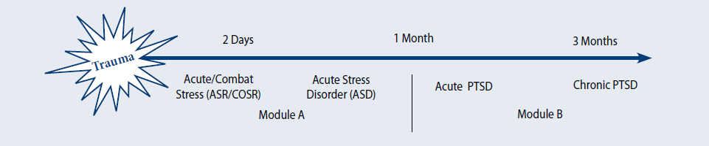
Traumatic Stress Continuum
Notes:
PTSD is one part of the broader spectrum called the “The impact of trauma is best conceptualized as a continuum (i.e., “traumatic stress continuum” starting at the moment of exposure to trauma (Time 0). From this point on, some people may be affected by trauma and display trauma-related symptoms, and some may not. For people who are displaying stress symptoms, these symptoms may be precursors to PTSD, as shown in the next slide

Slide 9
Precursors of PTSD
Acute Stress Reaction (ASR)
  Occurs within first 2-4 days of exposure to traumatic stress
  Symptoms typically recede within first few days
Acute Stress Disorder (ASD)
  Occurs from 4 -30 days after exposure
  Allows identification of personnel at high risk for developing PTSD
  If traumatic stress is not addressed successfully, can progress to PTSD (diagnosable after 30 days with symptoms)

Slide 10
Risk factors
Pre-traumatic factors | Peri-traumatic (related to trauma itself) | Post-traumatic factors
Ongoing life stress | Severe trauma | Ongoing life stress
Lack of social support | Physical injury to self or other | Lack of positive social support
Young age at time of trauma | Type of trauma as human-induced (e.g., combat, killing another person, torture, rape or assault) | Bereavement or traumatic grief
Pre-existing psychiatric disorders or substance abuse | High perceived threat to self or others | Major loss of resources
History of traumatic events (e.g., motor vehicle accident) | Community (mass) trauma | Negative social support (shaming or blaming environment)
History of PTSD | History of peri-traumatic dissociation and interpersonal trauma | Poor coping skills
Other factors (low socioeconomic status or education, family history, poor training or prep for traumatic event) |  | Other post-traumatic factors, including: children at home and/or a distressed spouse.

Slide 11
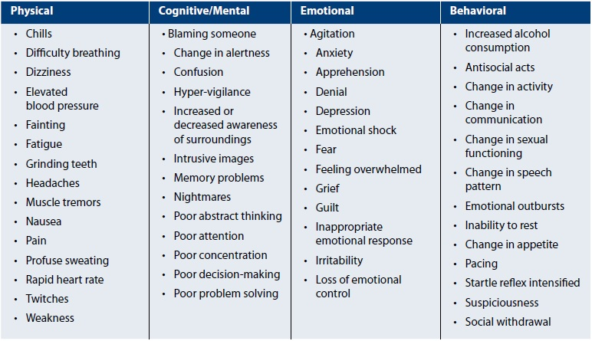
Common PTSD Symptoms

Slide 12
Other forms of PTSD
Subthreshold (or partial) PTSD
  Showing some symptoms of posttraumatic stress disorder, but with too few to meet the criteria for PTSD
Delayed onset PTSD
  PTSD symptoms begin at least 6 months after exposure to a stressor

Slide 13
Prevalence of PTSD (Civilians having experienced trauma)
Notes:
Estimates are that about 10% of the general population will develop PTSD in their lifetime

Slide 14
Prevalence of PTSD (Military)
Notes:
PTSD rates are much higher for military personnel in combat (as high as 30%)

Slide 15
Prevalence of PTSD (Emergency responders)
Notes:
For emergency responders to 9/11, estimates of PTSD rates vary between 5.9% affected to more than 22% affected
One prominent estimate across all emergency responders puts PTSD rates at 17.7% (Haugen et al., 2012)

Slide 16
Prevalence of PTSD after 9/11
Category of personnel | Time Frame | Prevalence
Rescue Workers | 10-61 months after 9/11 | 11.1%
Rescue Workers | 17-27 months | 5.9%
Rescue Workers | 2-3 years | 12.4%
Firefighters | 4-6 years | 22%
Utility Workers | 17-27 months | 5.9%
Utility Workers | 10-34 months | 8%

Slide 17
Co-occurring Conditions
Other challenges associated with PTSD:
  Psychiatric: e.g., depression, substance abuse disorders, suicide risk
  Medical: e.g., chronic pain, TBI, spinal cord injury
  Psychosocial: e.g., relationship problems, difficulties in social settings, intimate partner violence, child maltreatment, unemployment, homelessness, incarceration

Slide 18

“Take home” messages - 1
PTSD must be deliberately and proactively managed
Most people do not get PTSD even after they experience traumatic stress
Traumatic stress is a continuum – managing earlier is better
Both first responders and receivers are susceptible
Onset of PTSD can be delayed by months
Risk of PTSD depends on kind of trauma encountered

Slide 19


Prevention of PTSD
Prevention efforts can happen either before or after the traumatic event
Two routes to prevention:
  Education and Training Programs
  Screening for Trauma-Related Symptoms
Notes:
Efforts to prevent PTSD can focus on protecting people before exposure (i.e., in the absence of trauma) or working with them after exposure to decrease the severity of their symptoms and to limit their progression on the traumatic stress continuum (e.g., from acute stress reaction, to acute stress disorder to PTSD).

Slide 20
Prevention of PTSD (before trauma)
“In high-risk occupations, for which the probability of trauma exposure is moderate or high, efforts should be undertaken to increase the psychological resilience of workers to the negative effects of traumatic exposure.” (U.S. Department of Defense, 2010)
Unfortunately, although it is agreed to be important, not very well developed literature – no clear and easy way to prevent evident in the literature
Notes:
Efforts to prevent PTSD can focus on protecting people before exposure (i.e., in the absence of trauma) or working with them after exposure to decrease the severity of their symptoms and to limit their progression on the traumatic stress continuum (e.g., from acute stress reaction, to acute stress disorder to PTSD).

Slide 21
Education/Training
Guidelines for preventative education and training:
  Promote realism in training, with “vicarious, simulated or actual exposure to traumatic stimuli”
  Emphasize coping skills (e.g., cognitive restructuring, problem-solving)
  Promote highly cohesive working environments
  Promote adaptive beliefs about one’s work role and probable traumatic stressors
  Tailor stress-management programs to specific workplaces
  Educate about the traumatic stress continuum and other related behaviours (e.g., interpersonal problems, work issues, alcohol and substance abuse)
  Educate with positive messages about coping, provide simple strategies and encourage mastery/recovery

Slide 22
Regular screening is critical
“In terms of screening, evidence suggests that identifying PTSD early and quickly referring people to treatment can shorten their suffering and lessen the severity of their functional impairment.” (DoD, 2010, p. 5).
Need to screen for:
  Type of trauma – as noted earlier, some traumas are more problematic than others
  Frequency – including time since exposure
  Nature - distress level, functional impairment
  Severity – e.g., brief or prolonged exposure

Slide 23
Screening Requirements
Group | Frequency of screening | High risk criteria
All personnel | At least yearly, whether exposed or not
At risk personnel | Upon exposure and/or every 6 months (more frequently if high risk) | Recent trauma exposure High severity trauma History of PTSD See co-occurring conditions

Slide 24
Screening Tools
Measure | # of Items | Type/ Time | Reliability/ Validity Evidence | Feasibility for First Responders
Primary Care PTSD Screen (most common) | 4 | Self-Report | Med to High/ Med to High | ✓
Impact of Event Scale | 22 | Self-Report | High/High | ✓

Slide 25
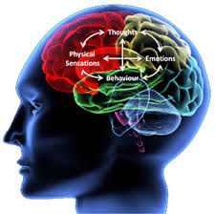

Treatment of PTSD
Notes:
http://www.google.ca/imgres?imgurl=http://ritasantos.co.uk/wp-content/uploads/2011/09/What-is-CBT_small_white.jpg&imgrefurl=http://ritasantos.co.uk/?page_id%3D117&h=299&w=300&sz=63&tbnid=3wMNujhedMufLM:&tbnh=124&tbnw=124&zoom=1&usg=__zy-9EjrJQSxYJKIjdgjLJOmV3rs=&docid=yw_bv7n5rEYEDM&sa=X&ei=Z2mTUqOiOYzlsATA0oGoBw&ved=0CDYQ9QEwAg

Slide 26
How should PTSD be treated?
Currently little strong research from emergency responder domain
Best advice is in military “best practice” guidelines – consistent with best practices in general but tailored to high-risk pragmatic domain
More research and validation of these guidelines for emergency responders is required

Slide 27
Immediate assessment upon exposure to traumatic stress
Scan for danger signs – Are there any serious concerns (e.g., danger to self or others) or changes in functioning??
YES
NO
GET PROFESSIONAL HELP
Support immediate needs and continue to assess
Notes:
Foa et al. (2002; cited in DoD, 2010, p. 33): For example - “…the routine assessment of all patients dealing with acute stress symptoms should involve a careful evaluation of current suicidal ideation and past history of suicidal attempts”
Personnel exposed to traumatic stress should be assessed immediately
Best practice guidelines emphasize the need for personnel who experience traumatic stress to be informally assessed within the first 4 days. This assessment should explore whether there are any serious concerns or behaviours (e.g., danger to self or others) and then to ensure that basic needs are met. Although current guidelines do not explore exactly who should be doing this assessment, presumably the responsibility would fall to team leaders/supervisors and/or assigned peers to make sure that the exposed member is supported and that any grave concerns are acted upon.

Slide 28
Treatment after initial exposure
If no danger signs, provide support (e.g., food, shelter, communication with family, orientation)
For many personnel, symptoms will recede after 4 days, and just informal treatments may be enough
Notes:
Foa et al. (2002; cited in DoD, 2010, p. 33):

Slide 29
Treatments
Cognitive behaviour therapy (CBT)
Psychoeducation/normalization
Psychological first aid
Social support systems
Psychological debriefing
Stress inoculation
Notes:
Foa et al. (2002; cited in DoD, 2010, p. 33):

Slide 30
Cognitive behaviour therapy (CBT)
Provided psychologists, therapists, mental health professionals
Many different kinds of overlapping forms of CBT
Targets problematic beliefs and tries to replace with more reality-based ones (e.g., survivor guilt, fears)
Lessens avoidance by encouraging “safe trauma”
Trauma-focused therapy (TFT) is more effective than non-TFT
CBT is most effective and best understood technique for treating PTSD – described as “treatment of choice”
Notes:
(DoD, 2010, p. 15).
(DoD, 2010, p. 25)

Slide 31
Stress inoculation
Focuses on helping people to better control their natural stress response (e.g., through breathing and relaxation exercises, to control their thinking (e.g., stopping negative thoughts) and using exposure techniques (e.g., in-vivo simulation).
Some limited support for treating PTSD but not strong body of relevant evidence

Slide 32
Social support
Supports from one’s social system (e.g., family members, friends, coworkers, peers, leaders)
Immediately after trauma exposure, preserve an interpersonal safety zone protecting basic personal space (e.g., privacy, quiet, personal effects).
Some evidence of its effectiveness at reducing risk of PTSD

Slide 33
Psychoeducation/normalization
Teach about stress and coping and stress continuum
Teach that acute stress reactions are common but transient and “do not indicate personal failure or weakness, mental illness or health problems”
Some limited evidence of its effectiveness at reducing risk of PTSD
Notes:
(DoD, 2010, p. 15).
(DoD, 2010, p. 25)

Slide 34
Psychological first aid
Defined as “provision of basic comfort, information, support and attendance to immediate practical and emotional needs” (p. 3).
Intended to help traumatized personnel to re-establish a sense of safety and self-efficacy and to reconnect with their natural support systems.
Some limited evidence of its effectiveness at reducing risk of PTSD
Notes:
(McEvoy, 2005, p. 3).

Slide 35
Psychological first aid
Element | Description
Contact and Engagement | Respond to contacts initiated by affected persons, or initiate contacts in a non-intrusive, compassionate, and helpful manner
Safety and Comfort | Enhance immediate and ongoing safety, and provide physical and emotional comfort
Stabilization (if needed) | Calm and orient emotionally overwhelmed or distraught survivors
Information Gathering – Current Needs and Concerns | Identify immediate needs and concerns, gather additional information, and tailor PFA interventions
Practical Assistance | Offer practical help to the survivor in addressing immediate needs and concerns
Connection with Social Supports | Help establish opportunities for brief or ongoing contacts with primary support persons or other sources of support, including family members, friends, and community helping resources
Information on Coping | Provide information (about stress reactions and coping) to reduce distress and promote adaptive functioning
Linkage to Collaborative Services | Link survivors with needed services and inform them about available services that may be needed in the future
Notes:
(McEvoy, 2005, p. 3).

Slide 36
Psychological debriefing
Most prominent form is Critical Incident Stress Debriefing (CISD)
Discussion led by a CISD facilitator (trained peer support person or mental health professional) helps to reduce stress and make sense of the event. Seven formal steps of CISD are:
  Introduction (ground rules and objectives)
  Facts (facts of the trauma reviewed)
  Thoughts and experience associated with event discussed
  Reactions phase – encouraged to vent feelings
  Review symptoms experienced
  Teaching – review of stress management strategies
  Re-entry phase – summary and wrap up

Slide 37
Psychological debriefing II
But, psychological debriefing is hotly contested
Lots of research in support of both sides but supportive research is very weak – critical research scientifically stronger
Current conclusion of most researchers is that it is problematic and should be avoided
In fact, there is now general agreement that it is not just ineffective, but actually harmful
General consensus is AVOID PSYCHOLOGICAL DEBRIEFING

Slide 38
Treatment – Best Practices
Treatment | Benefit vs. Harm | Scientific Status of Conclusion | Advice for First Responder/Receiver Community
Trauma-focused CBT (including exposure therapy) | Significant benefit | Strong evidence | ✓✓✓✓✓✓ - definitely use – empirically supported
Stress inoculation training | Some benefit | Inconclusive | ✓ - ok to use but not well researched
Social support | Some benefit | Inconclusive | ✓ - ok to use but not well researched
Education and normalization | Some benefit | Inconclusive | ✓ - ok to use but not well researched
Psychological first aid | Unknown benefit | Undetermined | ✓ - ok to use but not well researched

Slide 39
Treatment – AVOID
Treatment | Benefit vs. Harm | Scientific Status of Conclusion | Advice for First Responder/Receiver Community
Individual psychological debriefing | No benefit and POTENTIAL HARM | Not recommended | ✗ - do NOT use
Group psychological debriefing | Undetermined | No benefit seen but no evidence of harm | ✗ - do NOT use
Psychotherapy for personnel with no symptoms | No benefit and POTENTIAL HARM | Not recommended | ✗ - do NOT use

Slide 40
Treatment – Other
Treatment | Benefit vs. Harm | Scientific Status of Conclusion | Advice for First Responder/Receiver Community
Family therapy | Some benefit | Lacking evidence of benefit or harm | no basis
Web-based CBT | Unknown benefit | Lacking evidence of benefit or harm | no basis
Patient education Imagery rehearsal therapy Psychodynamic therapy Hypnosis Relaxation techniques Group therapy | Some benefit | Inconclusive | Weak empirical base
Notes:
There are lots of other treatments, but pretty unestablished – may be effective but research not yet done

Slide 41
Pharmacological Treatment
Treatment | Benefit vs. Harm | Scientific Status of Conclusion | Advice for First Responder/Receiver Community
SSRIs | Significant benefit | Strong scientific evidence, strongly recommended | ✓✓✓✓✓✓ - definitely use – empirically supported
SNRIs | Significant benefit | Strong scientific evidence, strongly recommended | ✓✓✓✓✓✓ - definitely use – empirically supported
Mirtazapine, Prazosin (for sleep/nightmares), Tricyclic antidepressants TCAs, Nefazodone (potential for drug-drug, drug-diet interactions**), MAOIs (phenelzeine)** | Some benefit | Fair evidence | ✓✓ - recommended
Prazosin (global PTSD) | Unknown benefit | Some evidence but too close to determine
Benzodiazepines*, Tiagabine, Guanfacine, Valproate, Topiramate, Risperidone | No benefit and POTENTIAL HARM | Not recommended
Atypical antipsychotics (Except Risperidone), Conventional antipsychotics. Busiprome, Non-Benzodiazepine hypnotics.Bupropion, Trazodone (adjunctive).Gabapentin, Lamotrigine. Propranolol, Clonidine | Unknown benefit |  | Lacking evidence, benefits/harms undetermined

Slide 42
Diagnosing PTSD
Measure | # of Items | Type/ Time | Reliability/ Validity Evidence | Recommended for First Responders
PTSD Checklist (PCL) | 17 | Self-report/ 10 min | High/ High | ✓
Clinician Administered PTSD Scale (CAPS) | 30 | Clinician given/ 1 hr | High/ High | ✓
*Full scale obtained and available.
Notes:
PTSD can only be formally diagnosed by trained professionals
Although stress-related symptoms can be detected by anyone close to affected personnel, only trained professionals can make a diagnosis of PTSD. Ideally, this diagnosis is done using reliable and valid scales specifically developed for this purpose. The two most common scales in the literature that are likely to be useful in the emergency responder context are the PTSD Checklist (PCL) and the Clinician-Administered PTSD Scale (CAPS).

Slide 43
“Take home” messages - 2
Exposure to traumatic stress requires immediate assessment
Personnel showing danger signs should be referred to professionals immediately
Personnel requiring treatment should receive CBT from professionals
Other supports such as education and social supports ok for anyone
Personnel NOT showing symptoms should not be formally treated
Psychological debriefing should NOT be used

Slide 44
Way forward - General
Create the culture necessary to manage PTSD
Form and adopt coherent policies and practices
Include traumatic stress experts as part of team

Slide 45
Way forward - Specific
Baseline scan of emergency responder community PTSD practices and services
Validate “best practice” guidelines with experts
Scan PTSD services practices and services as implemented in military
Evaluate efficacy of prevention efforts
Develop or validate screening and diagnostic tools
Evaluate efficacy of PTSD treatments for emergency responders

Slide 46
Sample Projects
How much trauma and stress is too much?
What levels of exposure are safe?
Is it possible to create a tool for leaders to gauge cumulative exposure?
Tracking systems for identifying “at-risk” personnel

Slide 47
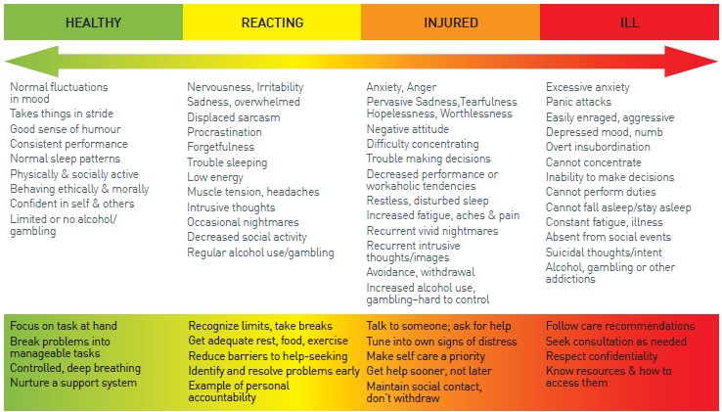
Develop or validate tools
Notes:
Tools like this one from the military domain (Mental health continuum; CF, 2013)
may be helpful for leaders to know what to look for (if shown to work effectively)

Slide 48
Conclusion
Organizations required to expose their personnel to high levels of risk and potential trauma need to work to create a culture of acceptance around the traumatic stress continuum and to work to provide a safe and supportive place for personnel to work through their natural reactions to traumatic exposure.
This review is a signal of the increased interest and concern about PTSD within the emergency responder community and will hopefully contribute to further planning, conversation, and the use of evidence-based treatment that will protect and support emergency responders from traumatic stress and PTSD.
Notes:
Mental health continuum (CF, 2013)

